Slide 1

SETU Code Lab
Diarmuid O’Neill
26/01/2026

Slide 2
Overview
What is it?
In-browser study tool
Platform to conduct coding labs
Problem statement for students
Large, abstract coding concepts are difficult
Difficult for students to stay focused and motivated
Problem statement for lecturers
Distributing, collecting and grading lab work for large classes
Giving students ways to revise for upcoming exams

Slide 3
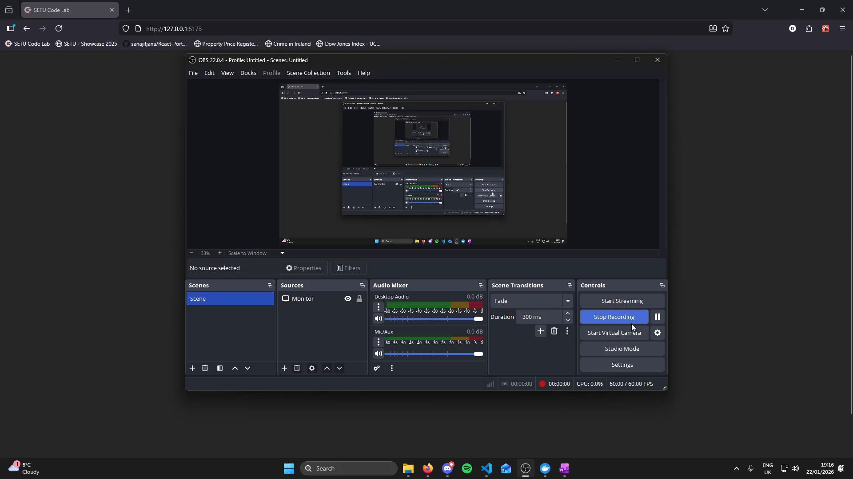

Slide 4
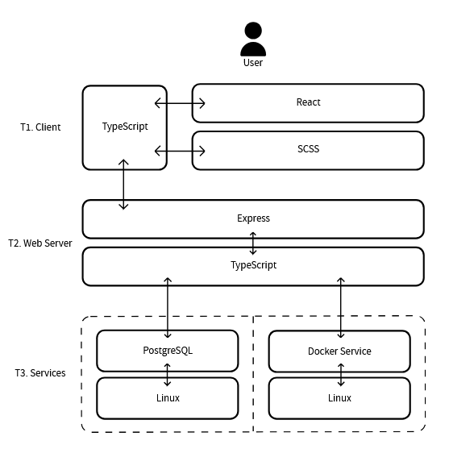

Slide 5
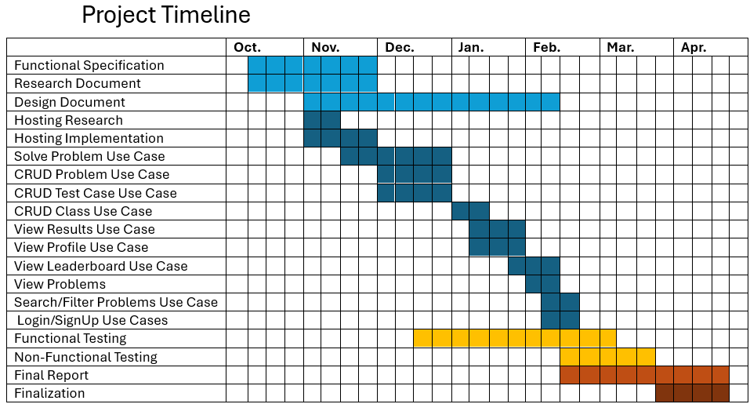
DONE
DONE
IN-PROGRESS
DONE
DONE
DONE
IN-PROGRESS
IN-PROGRESS
NOT STARTED
NOT STARTED
NOT STARTED
NOT STARTED
DONE
NOT STARTED
DONE
IN-PROGRESS
NOT STARTED
NOT STARTED
NOT STARTED

Slide 6

Any Questions?
Thank you for Listening

